Slide 1
CASE PRESENTATION
Presented by Marc Violides
Hope you enjoy!

Slide 2
1st step: Ask
Stakeholders expectation:
Create a cluster based on user pattern behavior: how do these clusters train?
How to resolve this question?
By country?
By category?
By aggregating data?
Intensity vs Number of programs?

Slide 3
2nd step: Prepare
What do I need to figure out how to solve this problem?
Data seems too simplistic, can I aggregate the data?
Find identifiable patterns in data to draw insightful conclusions
What research do I need to do?
Exploratory data analysis
What type of graph best suited to find identifiable pattern?
Are there outliers getting in the way? Do I get rid of them?

Slide 4
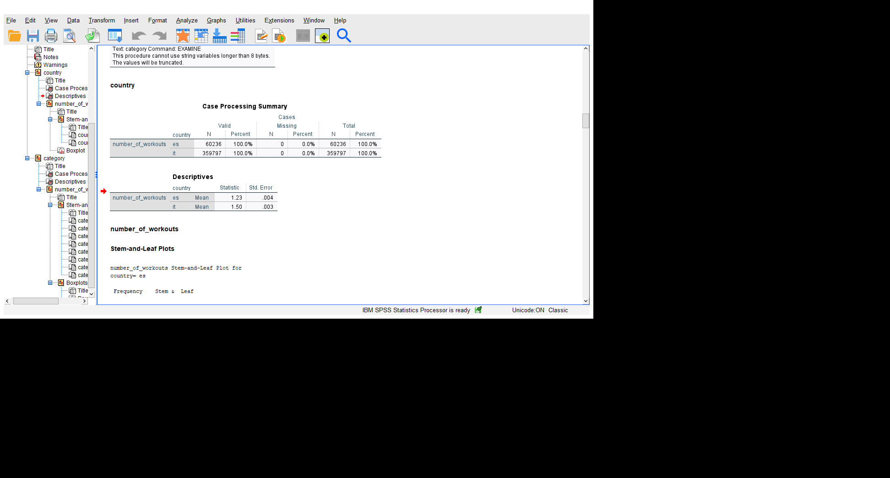
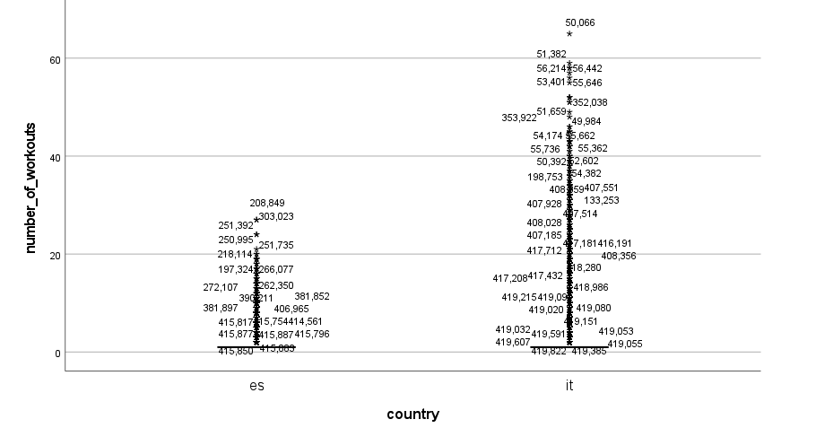
3rd Step: Process
Step 1: Is country worth looking at?

Slide 5
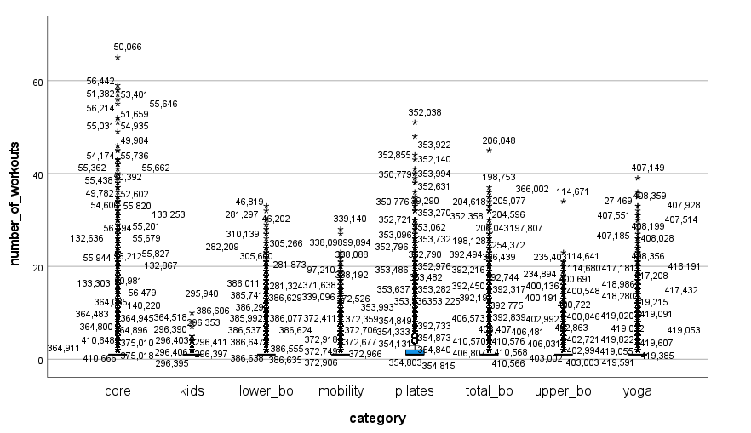
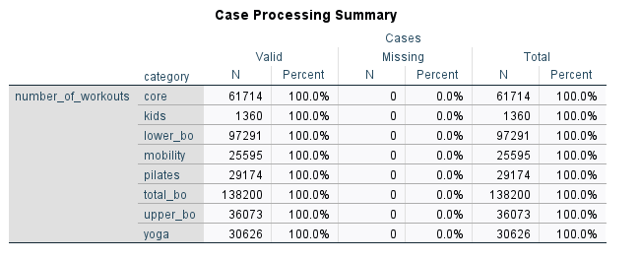
3rd Step: Process (Continued)
Step 2:Is category worth looking at?

Slide 6
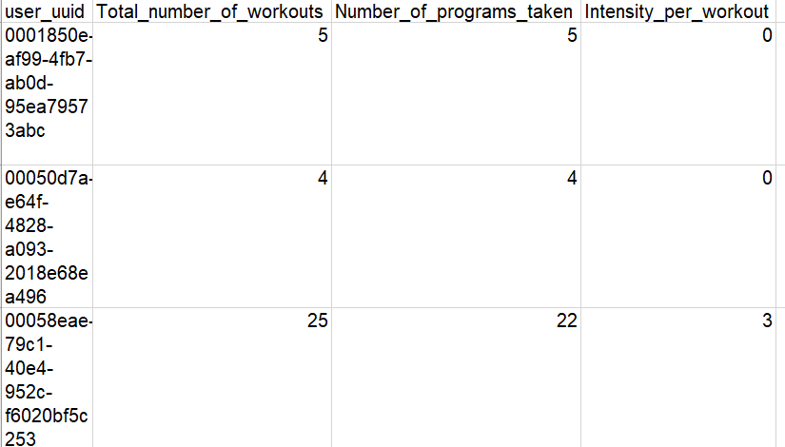
3rd Step: Process (Continued)
Step 3: Create pivot table to aggregate data

Slide 7
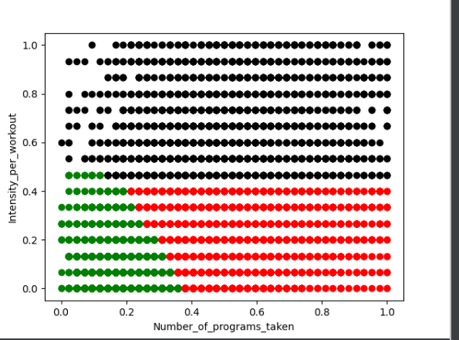
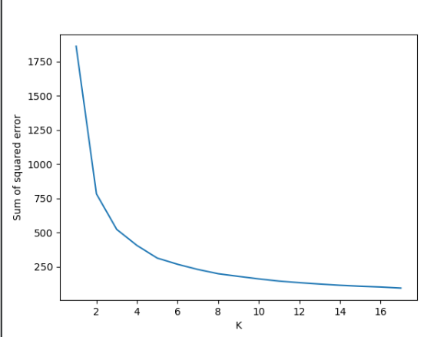
3rd Step: Process (Continued)
Step 4: Find clusters using K-means in python

Slide 8
4th step: Analyze
3 categories:
Green: Less active people ➔ low-to mid diversification and intensity
Green Campaign: send motivational notifications
Red: Diversified people ➔ mid-to-high diversification/ low-to-high intensity
Red Campaign: Make an abundance of short programs appear in their feed
Black: Intense people ➔ mid-to-high intensity
Black campaign: Make an abundance of programs with many workouts appear in feed

Slide 9
Now, you might ask…
How to access data present in each cluster to send specific mails?
SQL is your friend!
Less active
Diversified
Intense
select *
from data
where cluster = 0
select *
from data
where cluster = 1
select *
from data
where cluster = 2

Slide 10
Steps worth mentioning
Data cleaning (columns + outliers)
How I transferred the data from python to SQL

Slide 11
END OF THE PRESENTATION QUESTIONS?

